Slide 1
UNSW Business School/ Marketing
MARK 5826 Product Analytics
W5 – Recommendation System (2): Matrix Factorization
4 July 2019
Lecturer: Dr. Junbum Kwon
Matrix Factorization example by Dr. Lois Serrano
Contributors: Feng Yuan, Shuai Zhang, Flora Li

Slide 2
Content
Introduction of Matrix Factorization (MF)
Dependency among users and items
Dot product
Advantage of MF
How to find right factorization?
Math
Overfitting
Better Rating Model
CF model comparison

Slide 3


How does Netflix recommend movies? Matrix Factorization
https://www.youtube.com/watch?v=ZspR5PZemcs

Slide 4
Netflix Prize Competition
In 2006, $1 million prize if one improves accuracy by 10%
Training data:
500,000 users
17,000 movies,
100 million ratings
Test data: 3 million rating
Matrix Factorization was one of the most popular methods.

Slide 5
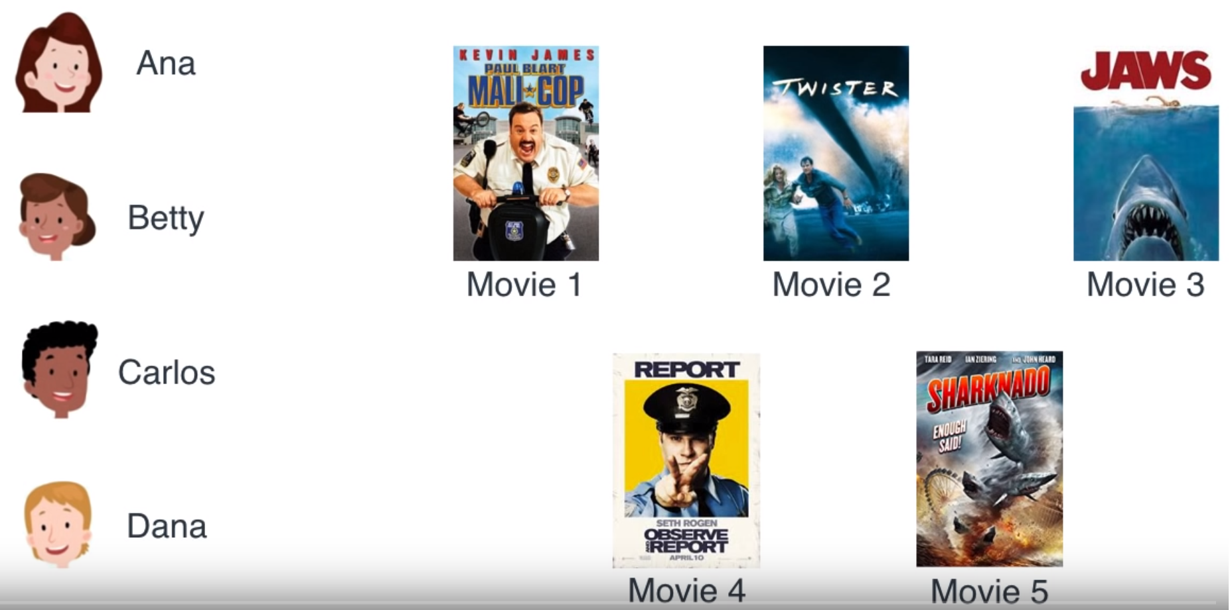
Netflix User-Movie Example

Slide 6
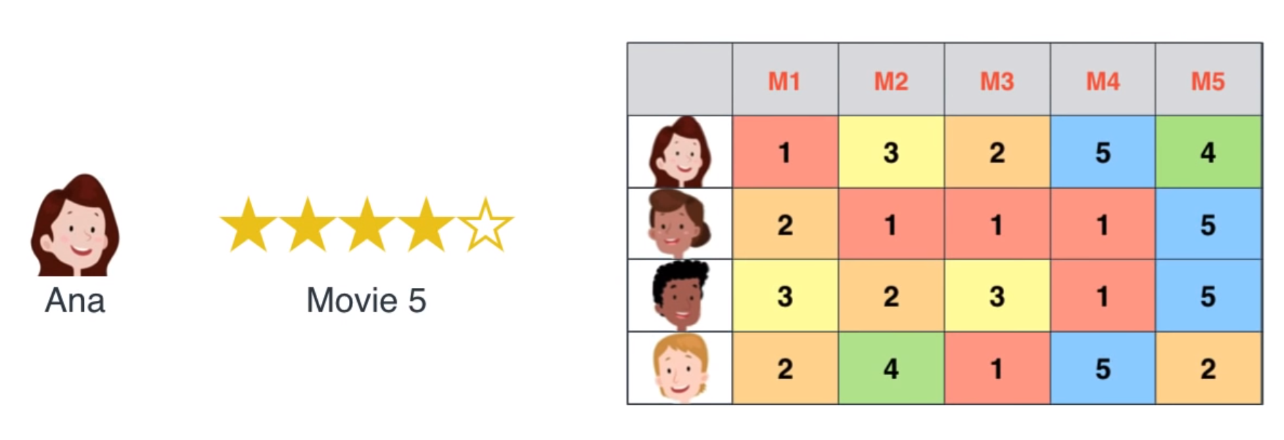
Netflix Ratings

Slide 7
Observation
Is there relation in ratings?
among users
among items

Slide 8
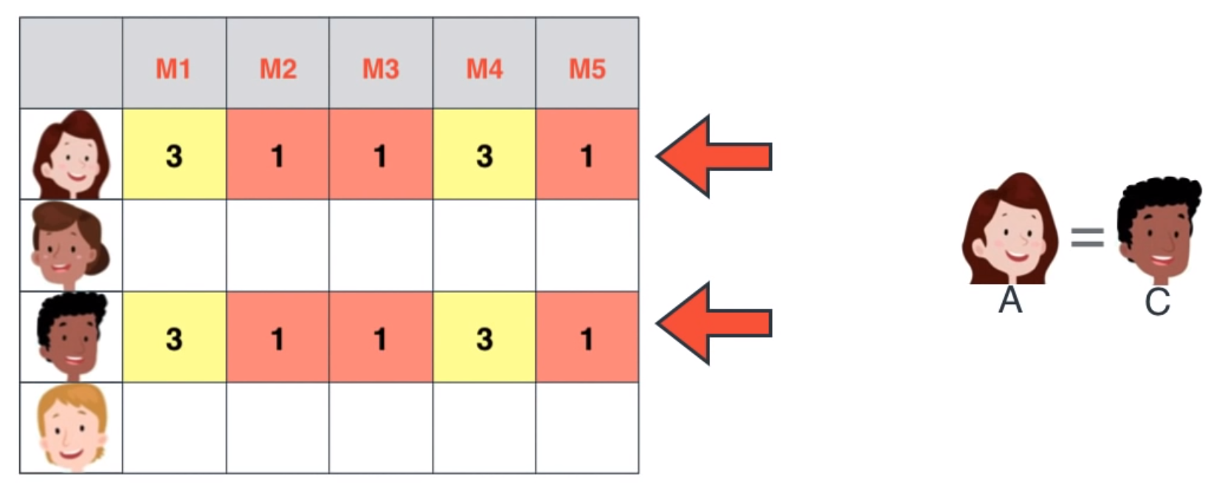
Dependent Rows and Columns
The same movie preference

Slide 9
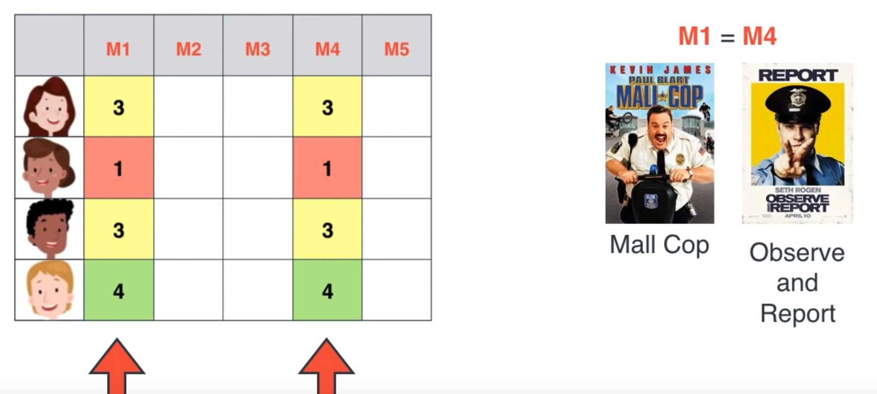
Dependent Rows and Columns
The same type of movie

Slide 10
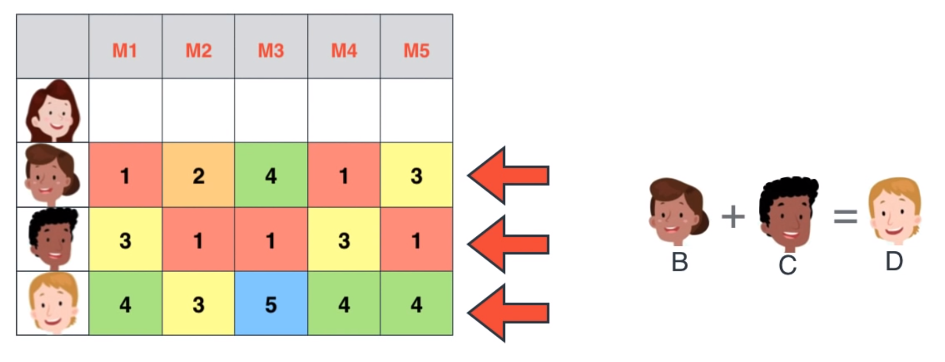
Dependent Rows and Columns
B + C = D ???
A
B
C
D

Slide 11
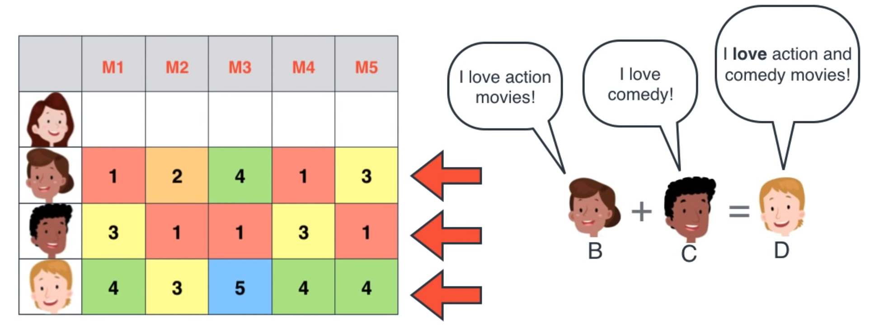
Dependent Rows and Columns
User D likes both types of movies.
A
B
C
D

Slide 12
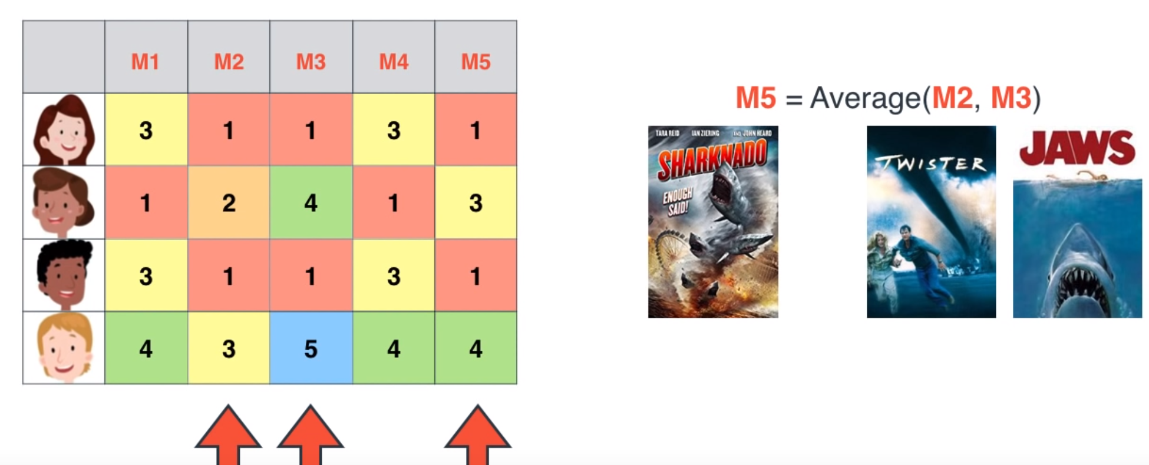
Dependent Rows and Columns
User D likes both types of movies.
A
B
C
D
Sharknado
= Shark + Tornado
Tornado
Shark

Slide 13
Dependent Rows and Columns
There are relations
between columns and
between rows
Such pattern can help people predict unknown values.

Slide 14
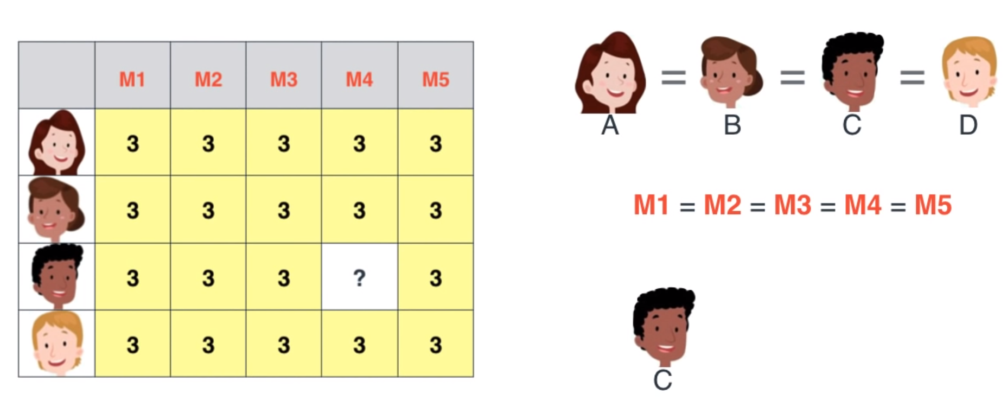
Guess ?
A
B
C
D

Slide 15
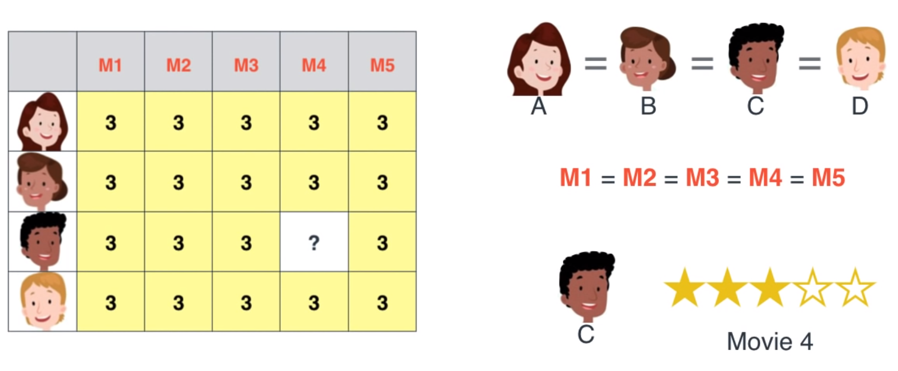
Guess ?
The same for all
A
B
C
D

Slide 16
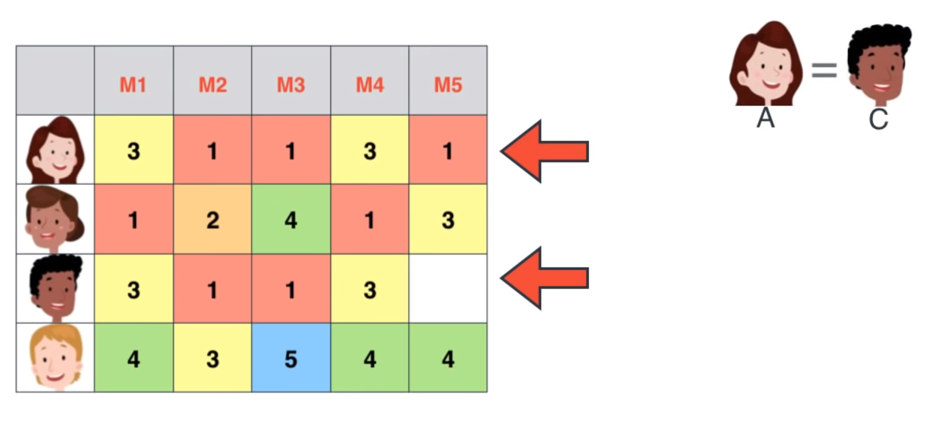
Guess ?
A
B
C
D

Slide 17
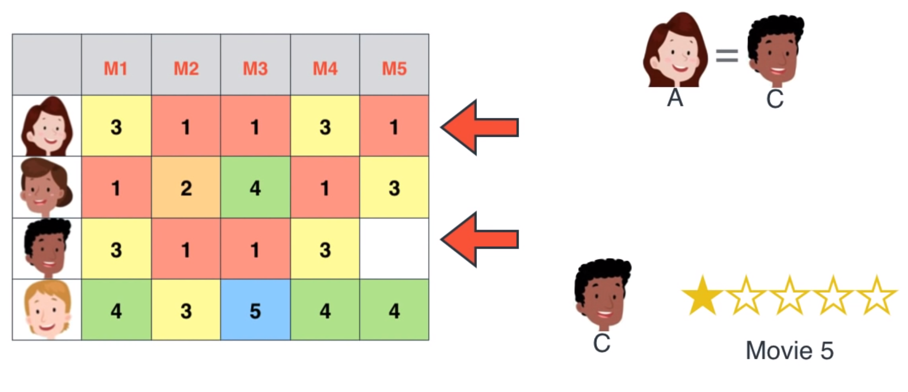
Guess ?
User A=C based on Movie 1,2,3, 4, although User C did not watch Movie 5 yet.
If there is good enough common behaviour, one can have good enough guess.
A
B
C
D

Slide 18
Dependent Rows and Columns
There are relations
between columns and
between rows
Such pattern can help predict unknown values (e.g. ratings)

Slide 19
Dependent Rows and Columns
How do you figure out all these dependencies (patterns)?

Slide 20
Dependent Rows and Columns
How do you figure out all these dependencies (patterns)?
Use Matrix Factorization! Then,
One can explain user-item ratings in terms of
Item (e.g. movie) features and
User preference

Slide 21
Factorization
Factor 1 x Factor 2 = Number
6 x 4 = 24
3 x 8 = 24
2 x 12 = 24

Slide 22
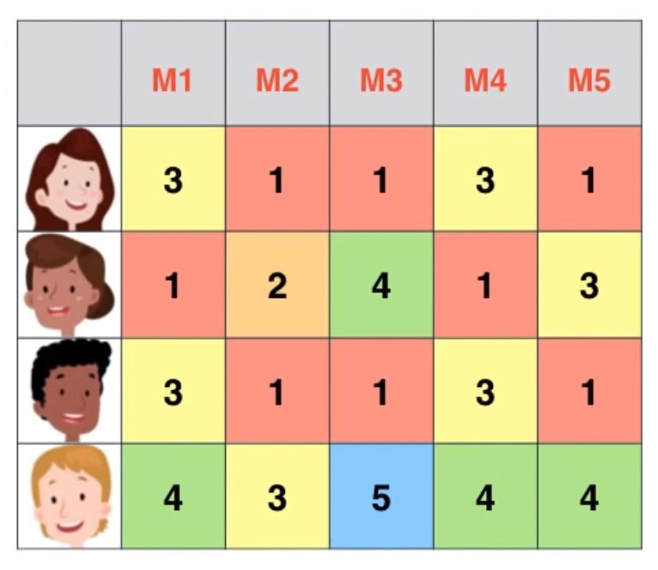
Matrix Factorization
Matrix A
x
Matrix B
=

Slide 23
Matrix Factorization
User Preference
x
Item (movie) Features
=

Slide 24

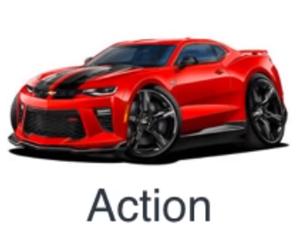


Movie Features
Item Features = Product Attributes
Scary

Slide 25
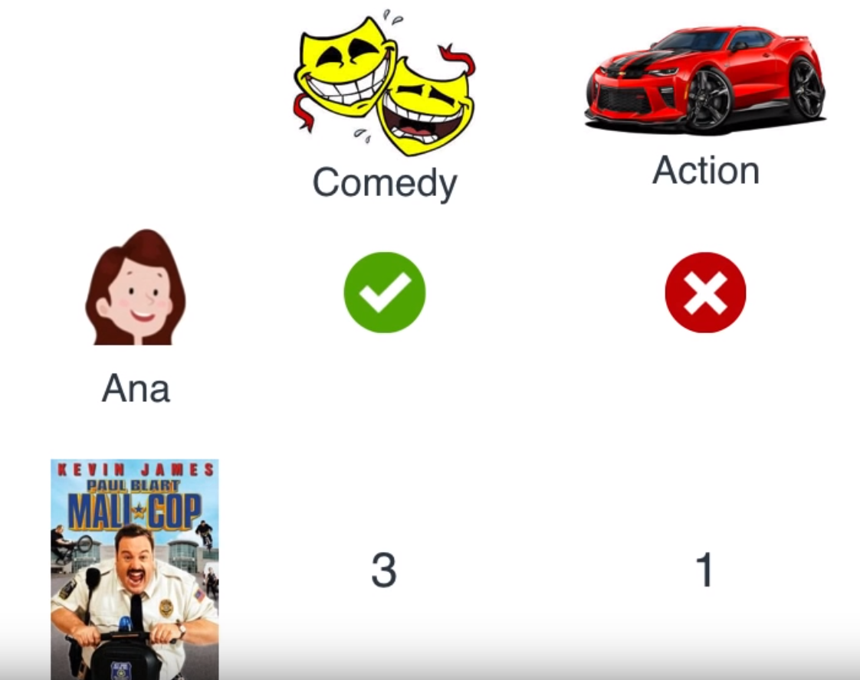
Movie Feature Level & User Preference Level
Movie Features
User
1
0
User preference level
Movie
Movie feature level

Slide 26
Rating calculation using Dot Product
The sum of the products of the corresponding entries of the two sequences of numbers.
Dot product of (1,0) and (3,1) = 1 x 3 + 0 x 1 = 3 + 0 = 3

Slide 27

Dot Product
(1 x 3 + 0 x 1)
Rating
=
User preference level on each feature
X
Movie feature level
=
1
0

Slide 28
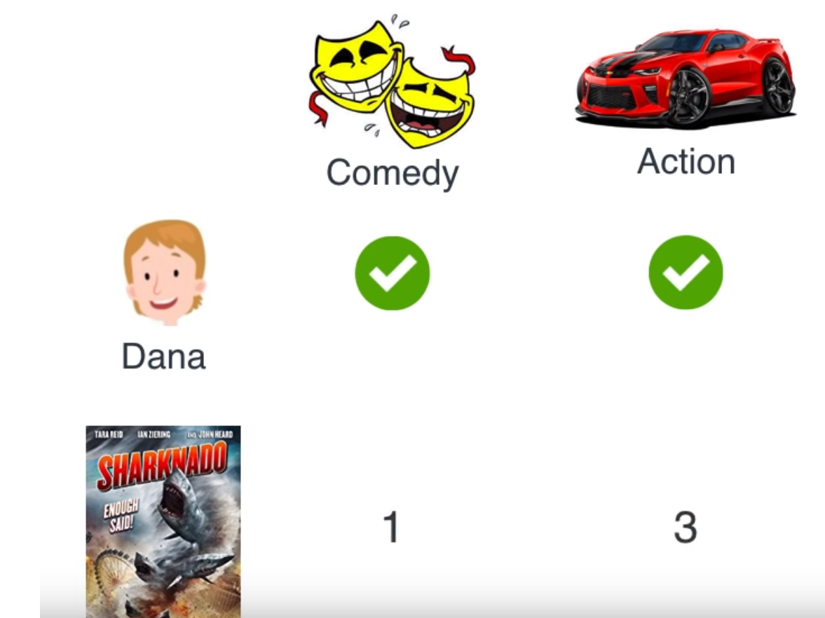
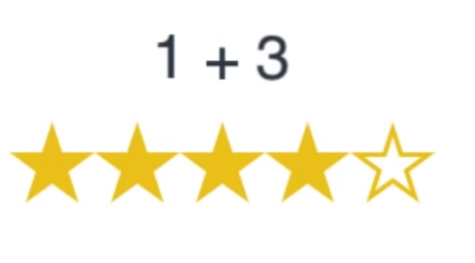
Dot Product
1
1

Slide 29
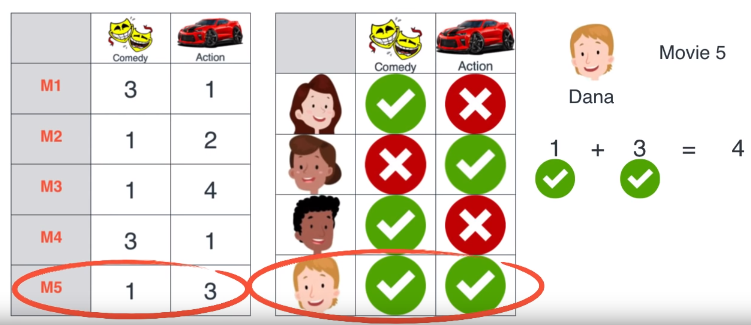
Dot Product
Movie feature level
User preference level

Slide 30
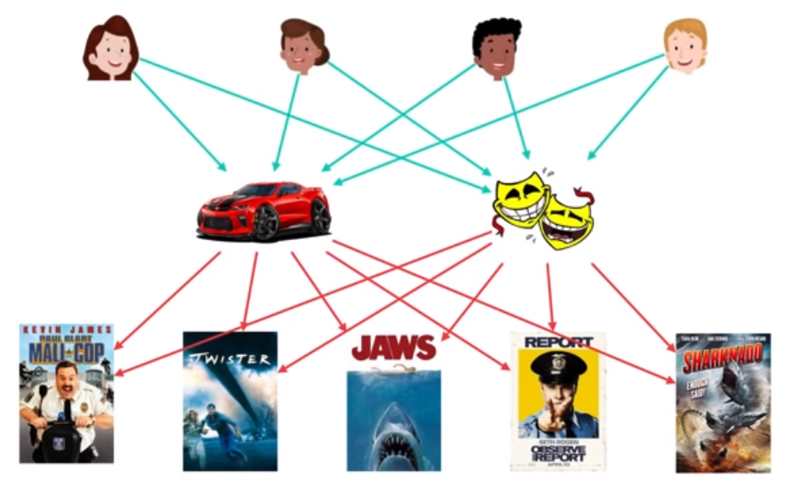
Rating calculation
Identify (1) User preference level and (2) Movie feature level
User
User preference level
Feature
Movie feature level
Movie

Slide 31
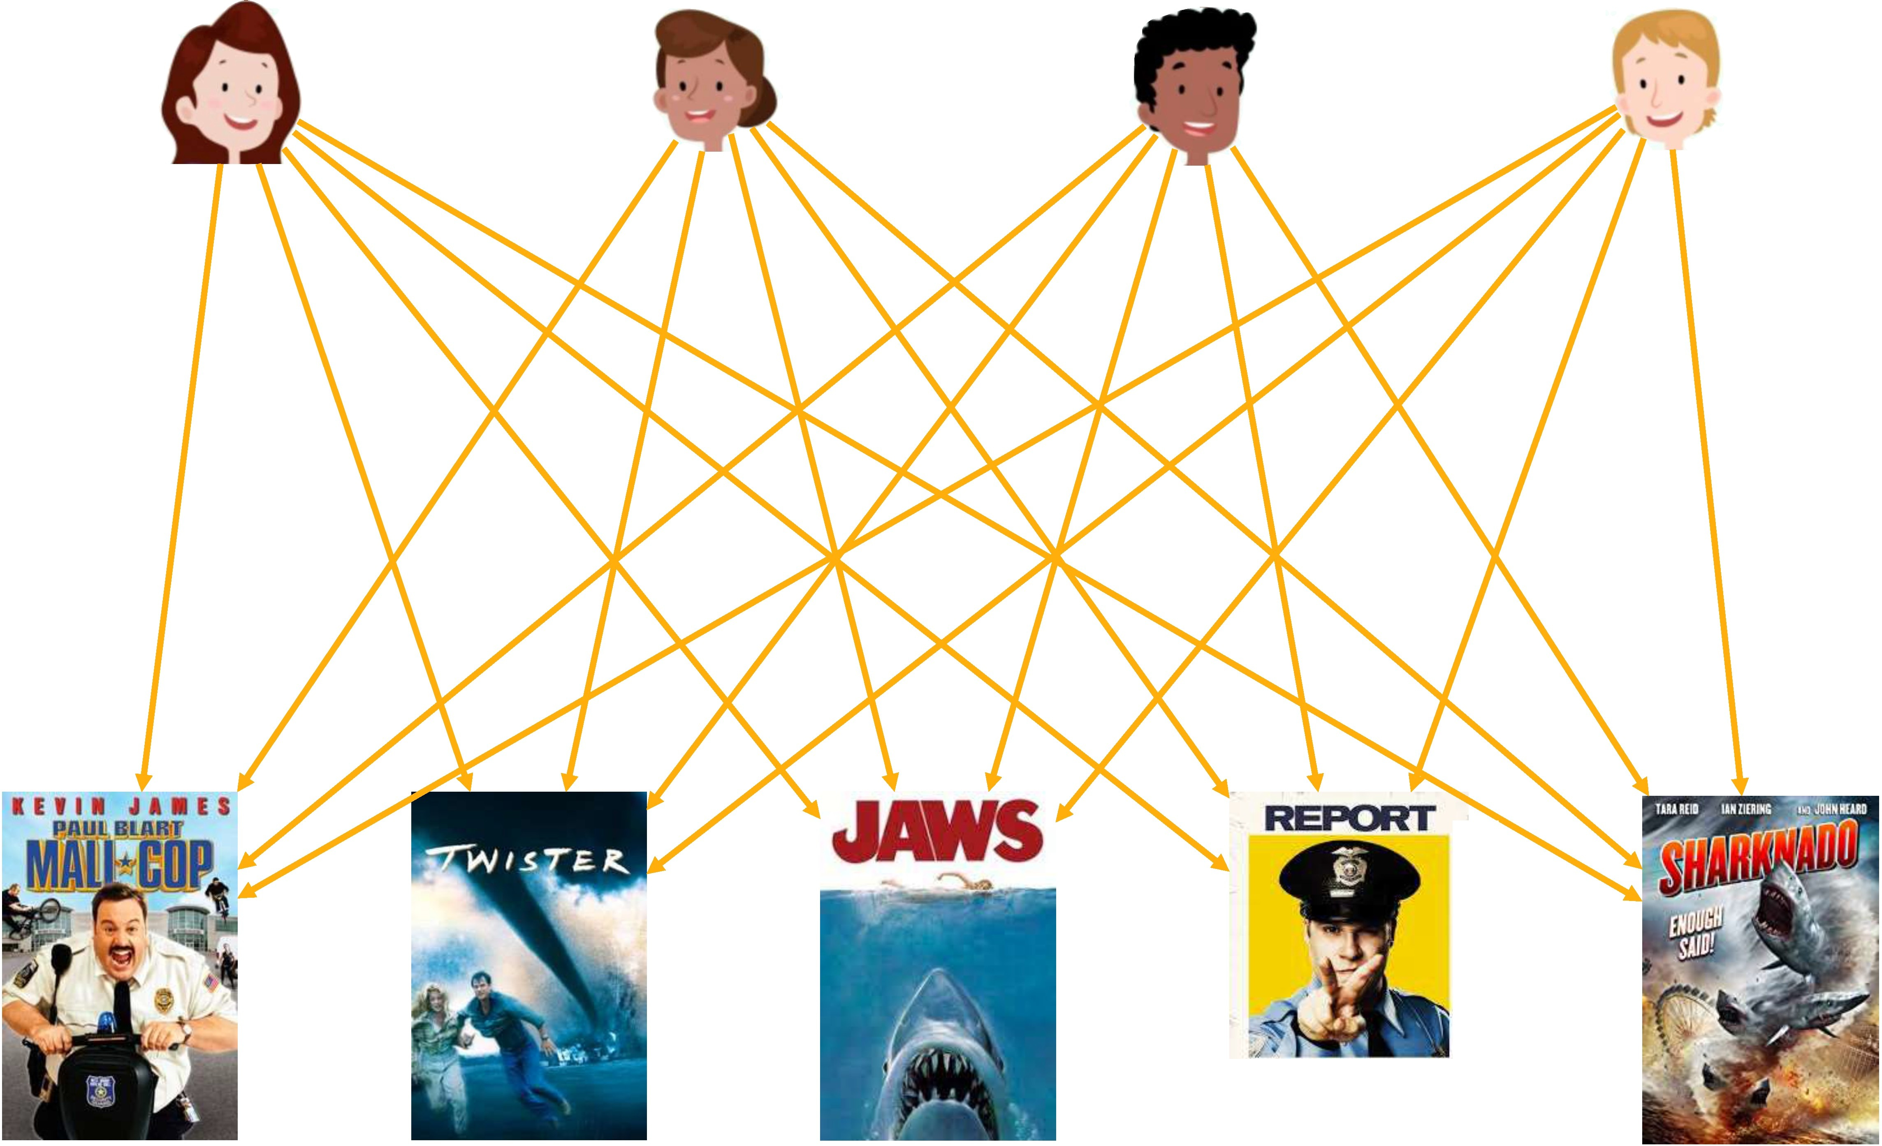
Rating calculation
Calculate ratings using dot products.
User
User preference level
Feature
Ratings
Movie feature level
Movie

Slide 32
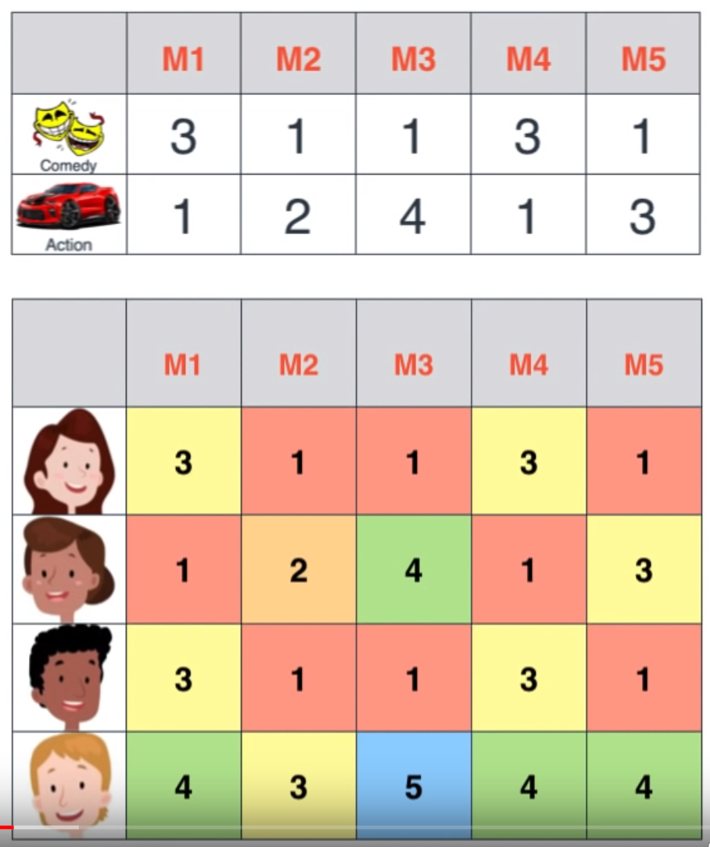
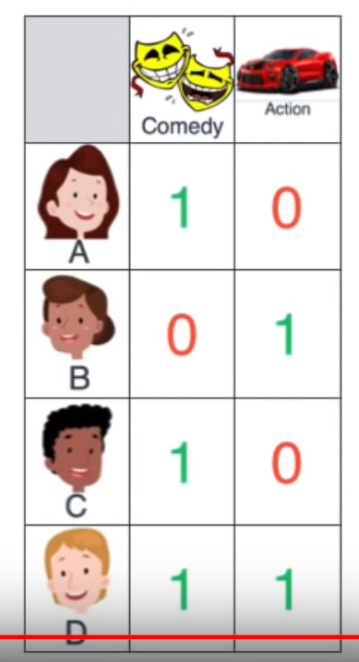
Rating calculation
Movie feature level
Once (1) user preference level and (2) movie feature level is identified, (3) all the ratings can be calculated using dot product.
User preference level

Slide 33
Do relations still hold?
Do relations b/w users in rating still hold in in user preference level?
Do relations b/w movies in rating still hold in in movie feature level?

Slide 34

Relation in User Preference Level
Movie feature level
Recall that D = B + C in rating vector.
The same in user preference vector.

Slide 35
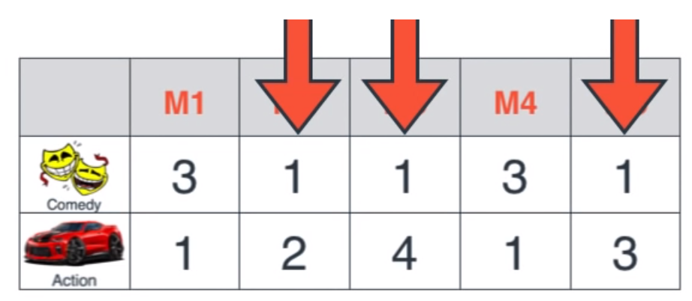
Relation in Movie Feature Level
Recall that M5 = (M2 + M3) / 2 in rating vector.
The same in movie feature vector.
User preference level

Slide 36
Advantage of Matrix Factorization
In practice, since each user watched only a few movies among all the Netflix movies, many ratings are empty (i.e. Sparse Matrix)
But, if there is good enough common behaviour, one can still identify user preference level and item feature level.
Then, one can do good enough guess for the ratings which is unobserved yet.

Slide 37
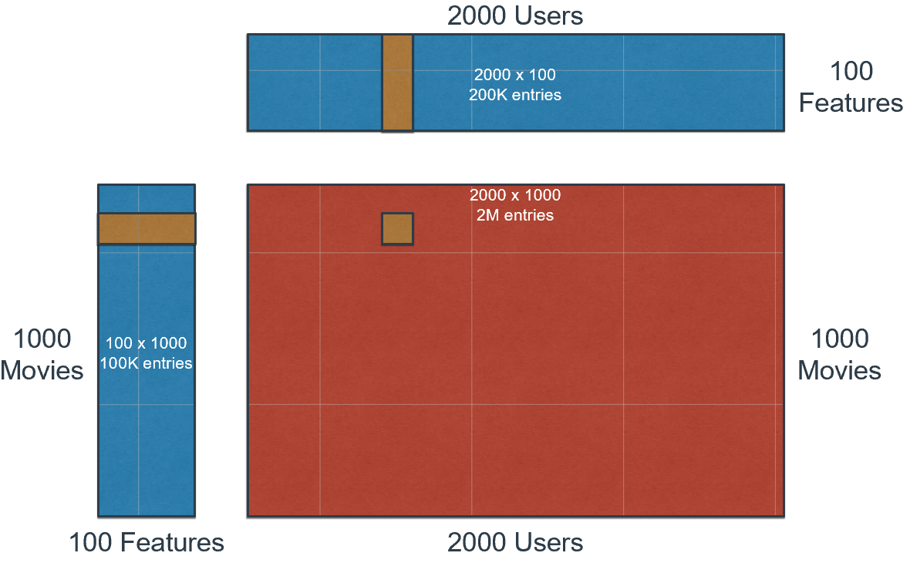
Advantage of Matrix Factorization
All the rating can be predicted using both
Movie Feature Levels and
User Preference Levels.

Slide 38
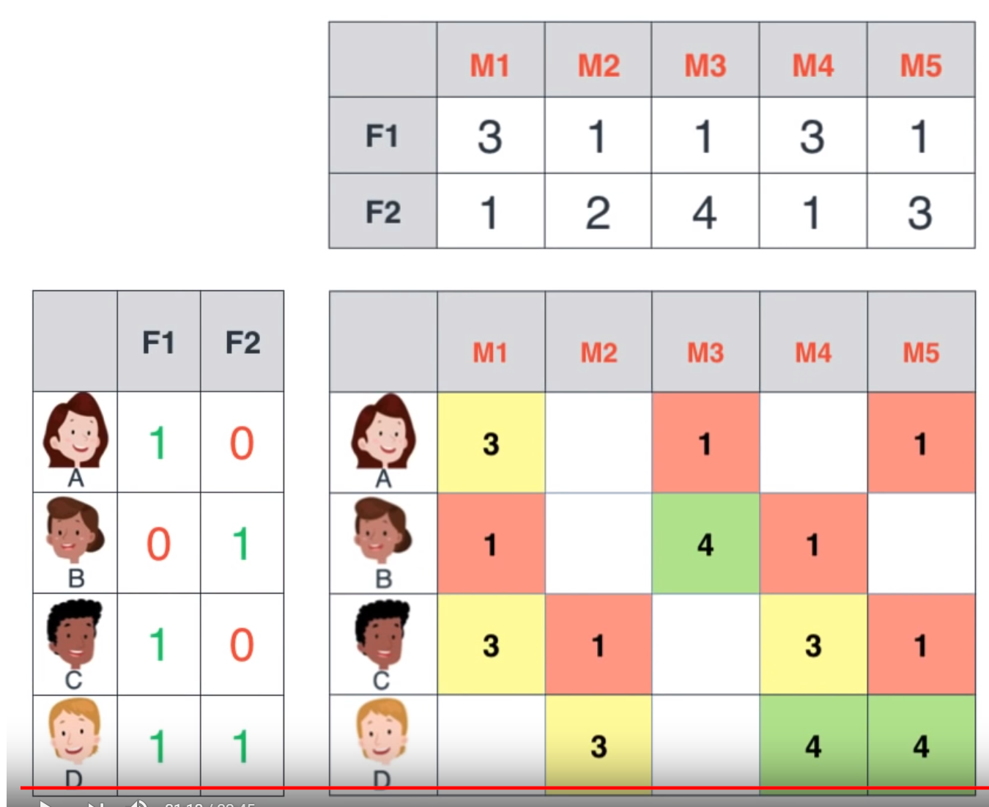
Advantage of Matrix Factorization - Predict the ratings in the white blank

Slide 39
Advantage of Matrix Factorization
- Predict the ratings in the white blank
- Which movie do you recommend for User D?

Slide 40
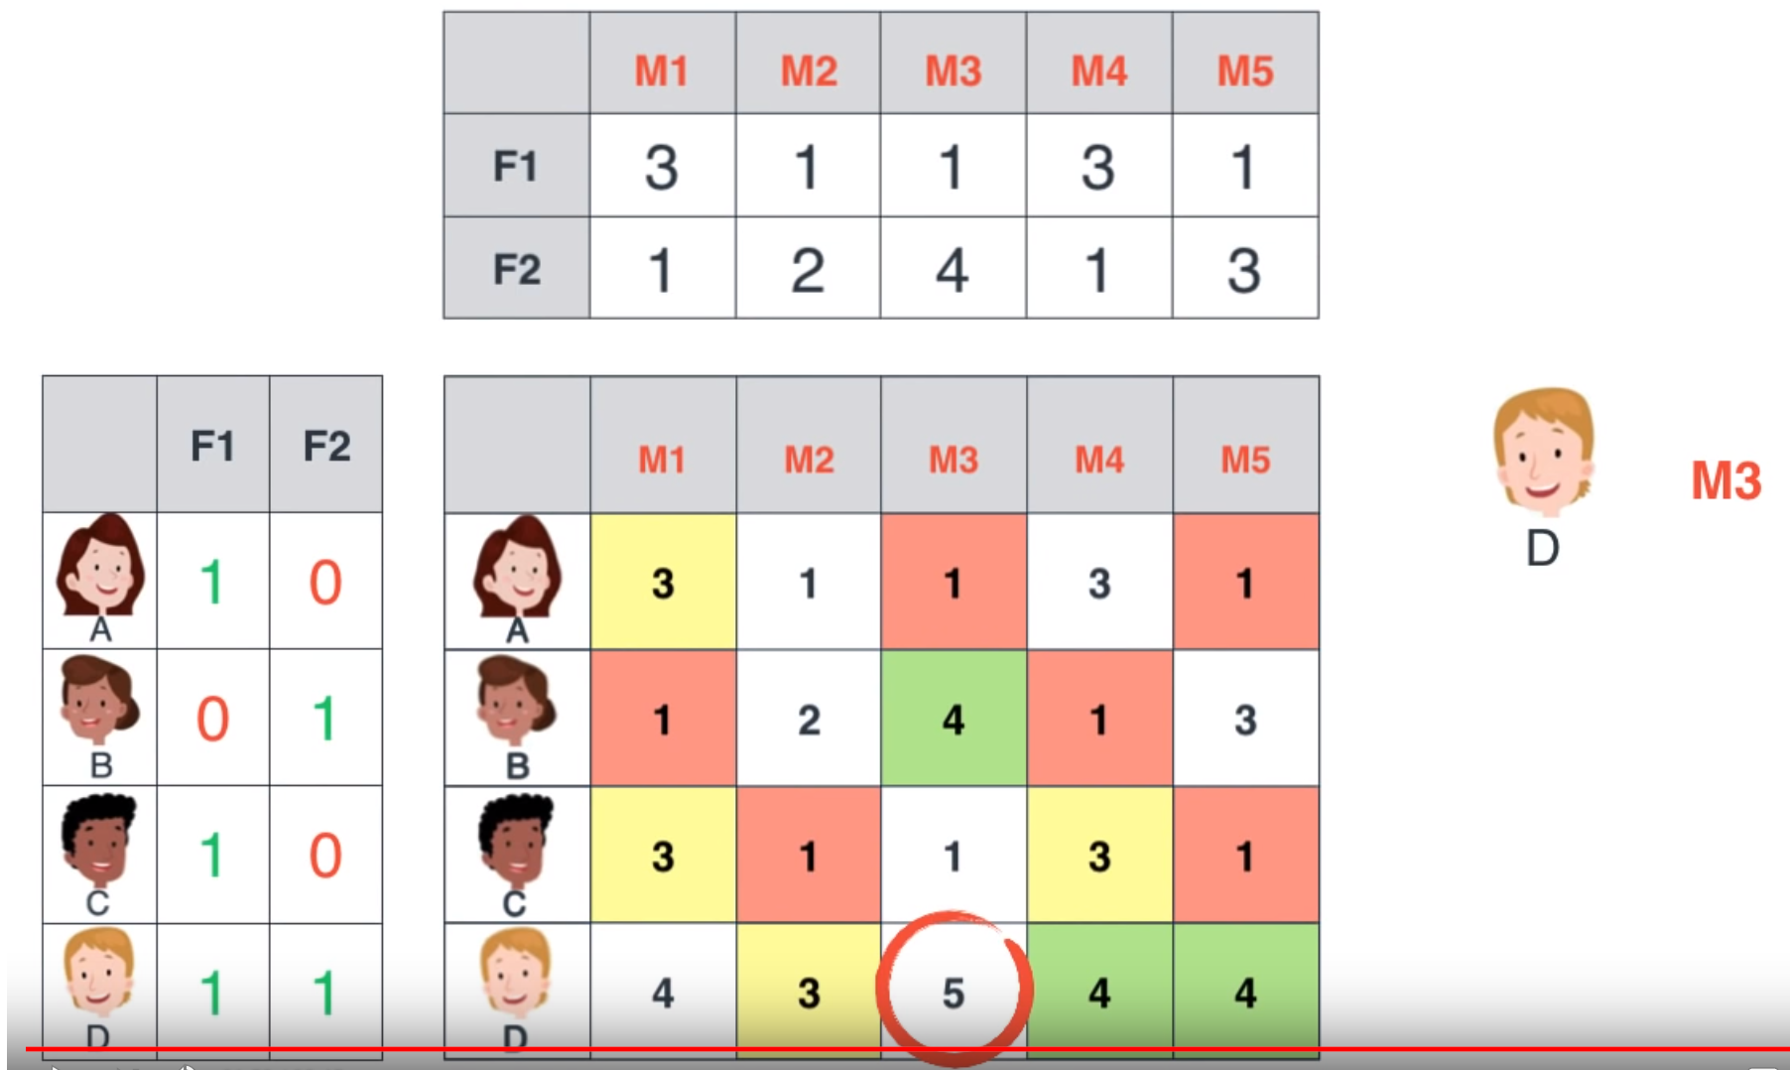
Advantage of Matrix Factorization

Slide 41
Then, how to find the right factorization?

Slide 42
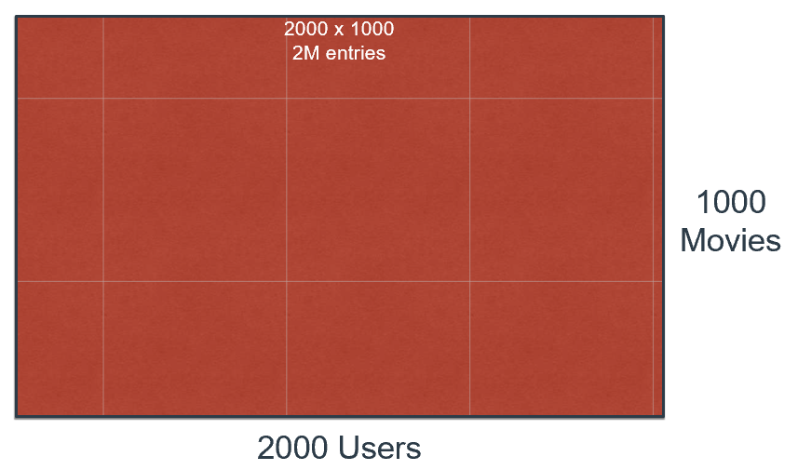
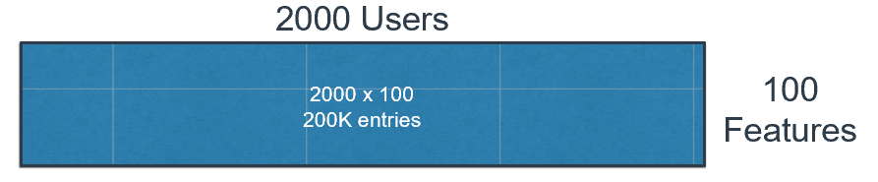
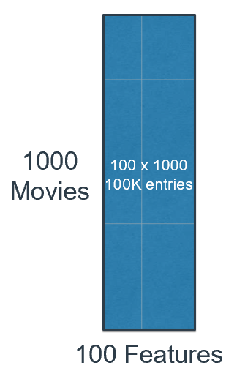
How to find the right factorization?
Output (Goal): Parameters to be estimated
Input data: Ratings
?
User Preference Level
Movie Feature Level

Slide 43






Training models
Nope
?

Slide 44


Training models
Nope
?

Slide 45


Close enough!
Training models
?

Slide 46
Why one can’t come up with solution at one time?
Many possible factors
1 x 4 = 4
2 x 2 = 24
3 x 1 = 24
Multi-dimensional
User1 – movie 2 rating depends on User 1 preference level and movie 2 feature level.
User1 – movie 3 rating depends on User 1 preference level and movie 3 feature level.
User2 – movie 3 rating depends on User 2 preference level and movie 3 feature level.

Slide 47
Why one can’t come up with solution at one time?
Many possible factors
1 x 4 = 4
2 x 2 = 24
3 x 1 = 24
Multi-dimensional
User1 – movie 2 rating depends on User 1 preference level and movie 2 feature level.
User1 – movie 3 rating depends on User 1 preference level and movie 3 feature level.
User2 – movie 3 rating depends on User 2 preference level and movie 3 feature level.

Slide 48
Solution: Trial, Error, Adjusting
Start with initial guess of parameters for users and items
Check errors (= rating – predicted errors)
Adjust the values of parameters to reduce the error (e.g. gradient decent direction)
Repeat the above steps until the error become small enough

Slide 49
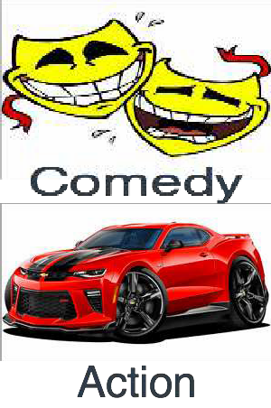
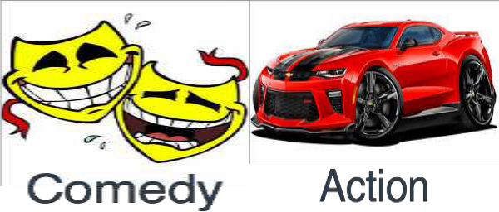




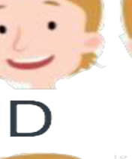

We know all the values.
 | M1 | M2 | M3 | M4 | M5
 | 3 | 1 | 1 | 3 | 1
 | 1 | 2 | 4 | 1 | 3
 | 1 | 0
 | 0 | 1
 | 1 | 0
 | 1 | 1
 | M1 | M2 | M3 | M4 | M5
 | 3 | 1 | 1 | 3 | 1
 | 1 | 2 | 4 | 1 | 3
 | 3 | 1 | 1 | 3 | 1
 | 4 | 3 | 5 | 4 | 4

Slide 50
How can we identify the values?
 | M1 | M2 | M3 | M4 | M5
 | ? | ? | ? | ? | ?
 | ? | ? | ? | ? | ?
 | ? | ?
 | ? | ?
 | ? | ?
 | ? | ?
 | M1 | M2 | M3 | M4 | M5
 | 3 | 1 | 1 | 3 | 1
 | 1 | 2 | 4 | 1 | 3
 | 3 | 1 | 1 | 3 | 1
 | 4 | 3 | 5 | 4 | 4

Slide 51
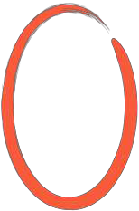
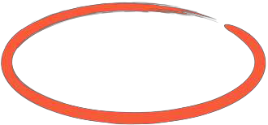

1.2 ^{x} 0.2 + 2.4 ^{x} 0.5 = 1.44
Initial Guess
 | M1 | M2 | M3 | M4 | M5
F1 | 1.2 | 3.1 | 0.3 | 2.5 | 0.2
F2 | 2.4 | 1.5 | 4.4 | 0.4 | 1.1
 | F1 | F2
 | 0.2 | 0.5
 | 0.3 | 0.4
 | 0.7 | 0.8
 | 0.4 | 0.5
 | M1 | M2 | M3 | M4 | M5
 | 3 | 1 | 1 | 3 | 1
 | 1 | 2 | 4 | 1 | 3
 | 3 | 1 | 1 | 3 | 1
 | 4 | 3 | 5 | 4 | 4

Slide 52

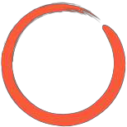
1.2 ^{x} 0.2 + 2.4 ^{x} 0.5 = 1.44
Dot Product
Predicted Ratings
 | M1 | M2 | M3 | M4 | M5
F1 | 1.2 | 3.1 | 0.3 | 2.5 | 0.2
F2 | 2.4 | 1.5 | 4.4 | 0.4 | 1.1
 | F1 | F2
 | 0.2 | 0.5
 | 0.3 | 0.4
 | 0.7 | 0.8
 | 0.4 | 0.5
M1 | M2 | M3 | M4 | M5
1.44 | 1.37 | 2.26 | 0.7 | 0.59
1.32 | 1.53 | 1.85 | 0.91 | 0.5
2.76 | 3.37 | 3.73 | 2.07 | 1.02
1.68 | 1.99 | 2.32 | 1.2 | 0.63
 | M1 | M2 | M3 | M4 | M5
 | 3 | 1 | 1 | 3 | 1
 | 1 | 2 | 4 | 1 | 3
 | 3 | 1 | 1 | 3 | 1
 | 4 | 3 | 5 | 4 | 4
M1
M2
M3
M4
M5

Slide 53
Predicted Rating < True Rating
 | M1 | M2 | M3 | M4 | M5
F1 | 1.2 | 3.1 | 0.3 | 2.5 | 0.2
F2 | 2.4 | 1.5 | 4.4 | 0.4 | 1.1
1.44 < 3
How to reduce the difference?
 | F1 | F2
 | 0.2 | 0.5
 | 0.3 | 0.4
 | 0.7 | 0.8
 | 0.4 | 0.5
M1 | M2 | M3 | M4 | M5
1.44 | 1.37 | 2.26 | 0.7 | 0.59
1.32 | 1.53 | 1.85 | 0.91 | 0.5
2.76 | 3.37 | 3.73 | 2.07 | 1.02
1.68 | 1.99 | 2.32 | 1.2 | 0.63
 | M1 | M2 | M3 | M4 | M5
 | 3 | 1 | 1 | 3 | 1
 | 1 | 2 | 4 | 1 | 3
 | 3 | 1 | 1 | 3 | 1
 | 4 | 3 | 5 | 4 | 4

Slide 54
 | M1 | M2 | M3 | M4 | M5
F1 | 1.2 | 3.1 | 0.3 | 2.5 | 0.2
F2 | 2.4 | 1.5 | 4.4 | 0.4 | 1.1
Increase the levels of movie 1 feature and user 1 preference
 | M1 | M2 | M3 | M4 | M5
 | 3 | 1 | 1 | 3 | 1
 | 1 | 2 | 4 | 1 | 3
 | 3 | 1 | 1 | 3 | 1
 | 4 | 3 | 5 | 4 | 4
F1 F2
M1
M2
M3
M4
M5
0.2 0.5
1.44
0.3 0.4
0.7 0.8
0.4 0.5

Slide 55
F1 F2
 | M1 | M2 | M3 | M4 | M5
F1 | 1.4 | 3.1 | 0.3 | 2.5 | 0.2
F2 | 2.5 | 1.5 | 4.4 | 0.4 | 1.1
 | M1 | M2 | M3 | M4 | M5
 | 3 | 1 | 1 | 3 | 1
 | 1 | 2 | 4 | 1 | 3
 | 3 | 1 | 1 | 3 | 1
 | 4 | 3 | 5 | 4 | 4
M1
M2
M3
M4
M5
0.3 0.6
0.3 0.4
0.7 0.8
0.4 0.5

Slide 56
1.4 ^{x} 0.3 + 2.5 ^{x} 0.6 = 1.92
 | M1 | M2 | M3 | M4 | M5
F1 | 1.4 | 3.1 | 0.3 | 2.5 | 0.2
F2 | 2.5 | 1.5 | 4.4 | 0.4 | 1.1
 | M1 | M2 | M3 | M4 | M5
 | 3 | 1 | 1 | 3 | 1
 | 1 | 2 | 4 | 1 | 3
 | 3 | 1 | 1 | 3 | 1
 | 4 | 3 | 5 | 4 | 4
F1 F2
M1
M2
M3
M4
M5
0.3 0.6
1.92
0.3 0.4
0.7 0.8
0.4 0.5

Slide 57
1.4 ^{x} 0.3 + 2.5 ^{x} 0.6 = 1.92
 | M1 | M2 | M3 | M4 | M5
F1 | 1.4 | 3.1 | 0.3 | 2.5 | 0.2
F2 | 2.5 | 1.5 | 4.4 | 0.4 | 1.1
 | M1 | M2 | M3 | M4 | M5
 | 3 | 1 | 1 | 3 | 1
 | 1 | 2 | 4 | 1 | 3
 | 3 | 1 | 1 | 3 | 1
 | 4 | 3 | 5 | 4 | 4
F1 F2
M1
M2
M3
M4
M5
0.3 0.6
1.92
1.83
0.3 0.4
0.7 0.8
0.4 0.5

Slide 58
3.1 ^{x} 0.3 + 1.5 ^{x} 0.6 = 1.83
Then, decrease the levels of movie 2 feature and user 1 preference
 | M1 | M2 | M3 | M4 | M5
F1 | 1.4 | 3.1 | 0.3 | 2.5 | 0.2
F2 | 2.5 | 1.5 | 4.4 | 0.4 | 1.1
1.83 > 1
 | M1 | M2 | M3 | M4 | M5
 | 3 | 1 | 1 | 3 | 1
 | 1 | 2 | 4 | 1 | 3
 | 3 | 1 | 1 | 3 | 1
 | 4 | 3 | 5 | 4 | 4
F1 F2
M1
M2
M3
M4
M5
0.3 0.6
1.92
1.83
0.3 0.4
0.7 0.8
0.4 0.5

Slide 59
Error function
(or Loss function)

Slide 60
You were wrong by 10.3
Training models
?

Slide 61
You were wrong by 5.32
Training models
?

Slide 62
You were wrong by 1.23
Training models
?

Slide 63
Error Function
 | M1 | M2 | M3 | M4 | M5
F1 | 1.2 | 3.1 | 0.3 | 2.5 | 0.2
F2 | 2.4 | 1.5 | 4.4 | 0.4 | 1.1
Error = (3 - 1.44)²
 | F1 | F2
 | 0.2 | 0.5
 | 0.3 | 0.4
 | 0.7 | 0.8
 | 0.4 | 0.5
 | M1 | M2 | M3 | M4 | M5
 | 3 | 1 | 1 | 3 | 1
 | 1 | 2 | 4 | 1 | 3
 | 3 | 1 | 1 | 3 | 1
 | 4 | 3 | 5 | 4 | 4
M1
M2
M3
M4
M5
1.44

Slide 64
Error Function
M1 M2 M3
F1 1.2 3.1 0.3
F2 2.4 1.5 4.4
M4
M5
Error = (3 - 1.44)²
+ (1 - 1.37)
+ …
2
2.5 0.2
0.4 1.1
 | M1 | M2 | M3 | M4 | M5
 | 3 | 1 | 1 | 3 | 1
 | 1 | 2 | 4 | 1 | 3
 | 3 | 1 | 1 | 3 | 1
 | 4 | 3 | 5 | 4 | 4
F1 F2
M1
M2
M3
M4
M5
0.2 0.5
1.44
1.37
0.3 0.4
0.7 0.8
0.4 0.5

Slide 65
Math

Slide 66
Matrix Factorization
Estimate Item Feature (P) and User Preference (Q) matrix from Rating Matrix (R).
Users
R
Q
P
k
X
Users
=
Items
Items
k
k = the number of latent features

Slide 67

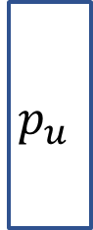

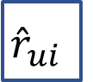
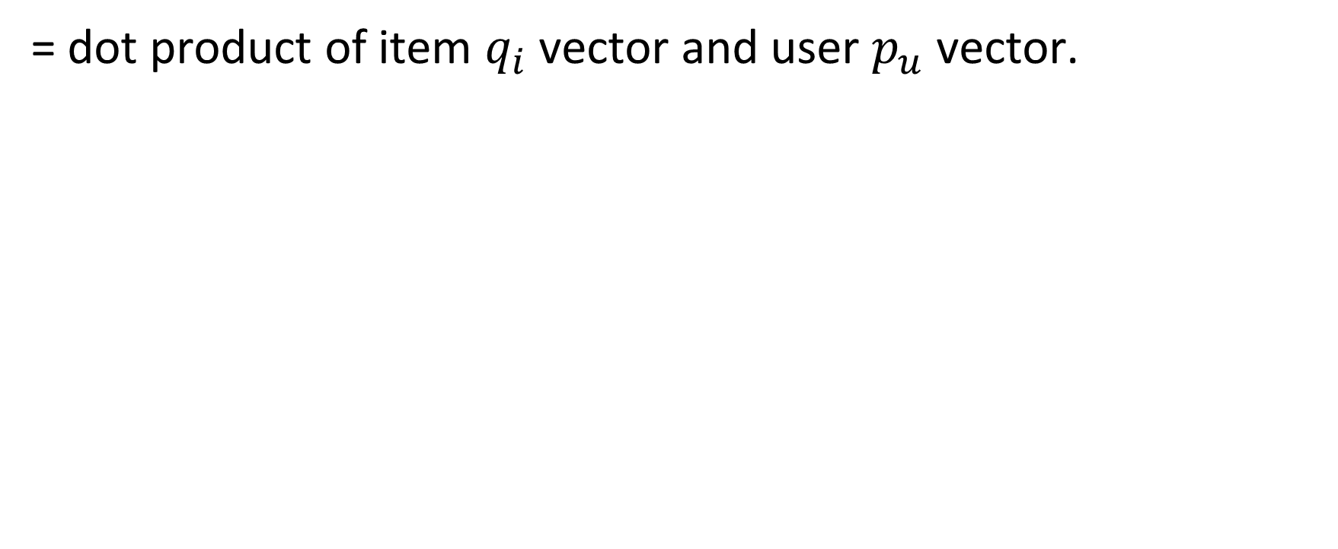
Predicted Rating ${\hat{r}}_{ui}$
= dot product of item $q_{i}$vector and user $p_{u}$ vector.
Users
$$p_{u}$$
k
X
Users
$${\hat{r}}_{ui}$$
Items
$$q_{i}^{T}$$
=
Items
k

Slide 68
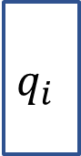
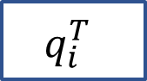
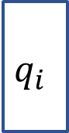
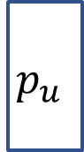

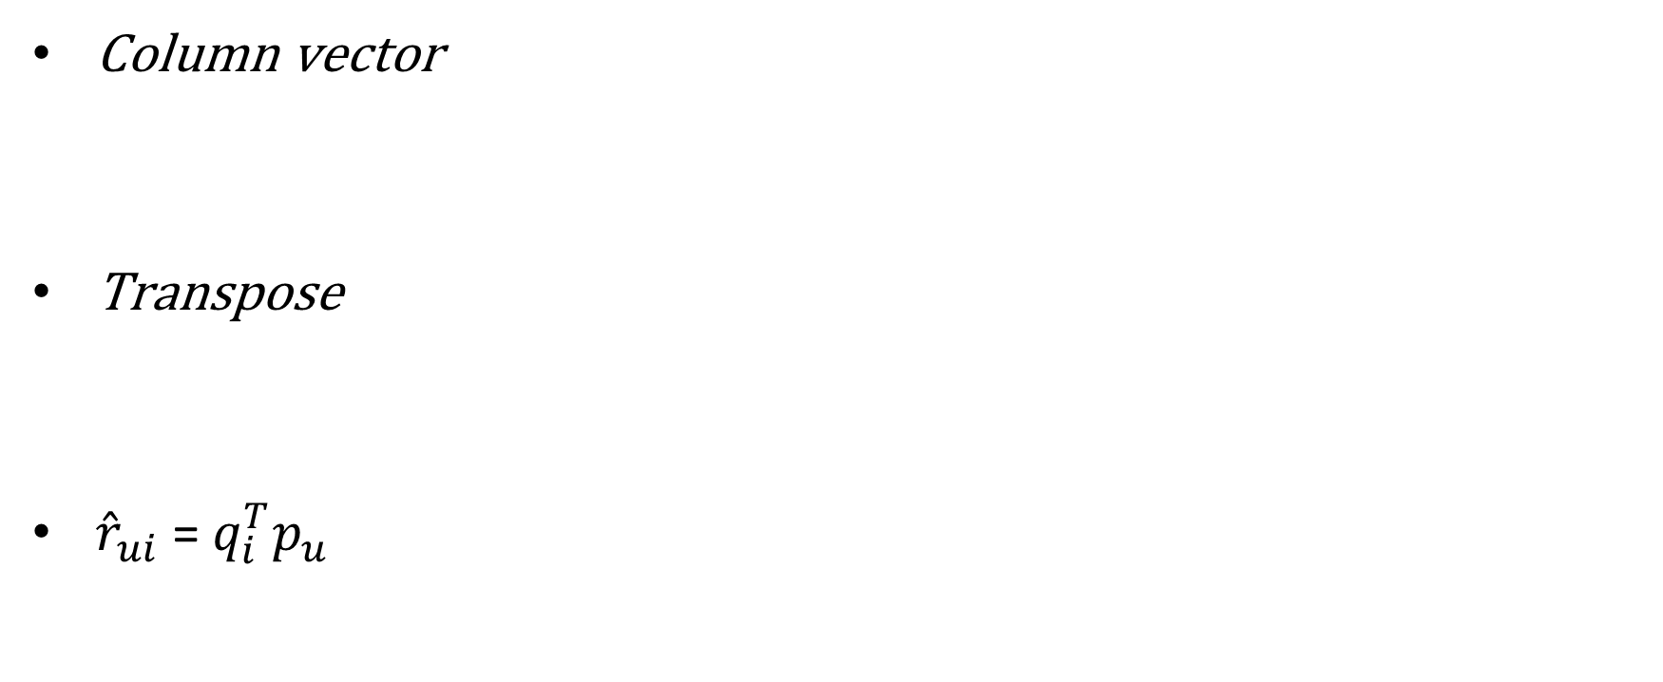
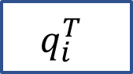
Predicted Rating ${\hat{r}}_{ui}$
Column vector
Transpose
${\hat{r}}_{ui}$= $q_{i}^{T}p_{u}$
$$q_{i}$$
$$p_{u}$$
$$q_{i}$$
$$q_{i}^{T}$$
$$q_{i}^{T}$$
$$p_{u}$$
(Dot Product)

Slide 69
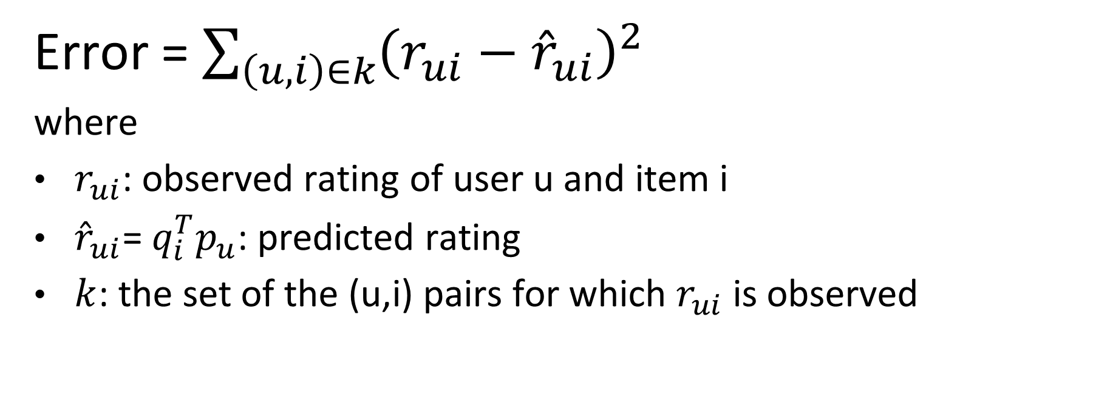
Error Function (or Loss Function)
Error = $\sum_{\left(u,i\right)∈k}{{\left(r_{ui}−{\hat{r}}_{ui}\right)}^{2}}$
where
$r_{ui}$: observed rating of user u and item i
${\hat{r}}_{ui}\text{= }q_{i}^{T}p_{u}$: predicted rating
$k$: the set of the (u,i) pairs for which $r_{ui}$ is observed

Slide 70
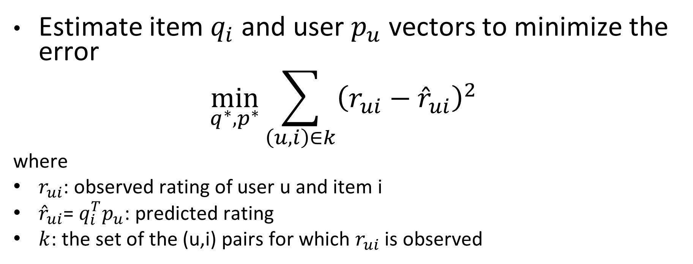
The Goal of Matrix Factorization
Estimate item $q_{i}$and user $p_{u}$ vectors to minimize the error
$$\min_{q^{∗},p^{∗}}{\sum_{\left(u,i\right)∈k}{{\left(r_{ui}−{\hat{r}}_{ui}\right)}^{2}}}$$
where
$r_{ui}$: observed rating of user u and item i
${\hat{r}}_{ui}\text{= }q_{i}^{T}p_{u}$: predicted rating
$k$: the set of the (u,i) pairs for which $r_{ui}$ is observed

Slide 71
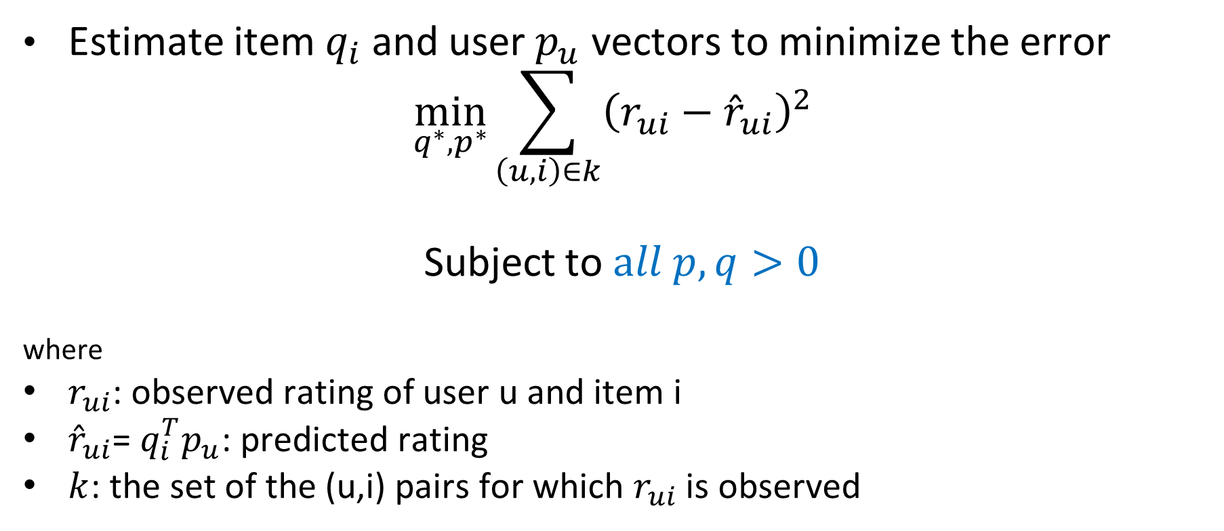
Non-Negative Matrix Factorization
Estimate item $q_{i}$and user $p_{u}$ vectors to minimize the error
$$\min_{q^{∗},p^{∗}}{\sum_{\left(u,i\right)∈k}{{\left(r_{ui}−{\hat{r}}_{ui}\right)}^{2}}}$$
Subject to $all p, q>0$
where
$r_{ui}$: observed rating of user u and item i
${\hat{r}}_{ui}\text{= }q_{i}^{T}p_{u}$: predicted rating
$k$: the set of the (u,i) pairs for which $r_{ui}$ is observed

Slide 72
Training and Testing data
You build model (i.e. estimate parameters or weights) with “training” data.
You compare model’s prediction error with “testing” data.
If you make too complex model (e.g. too extreme values of parameters) with “training” data, your model might show very high error in “testing” data.

Slide 73
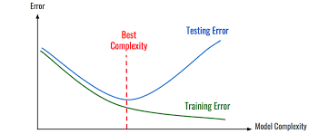
Overfitting
Complex models often increase testing error.

Slide 74
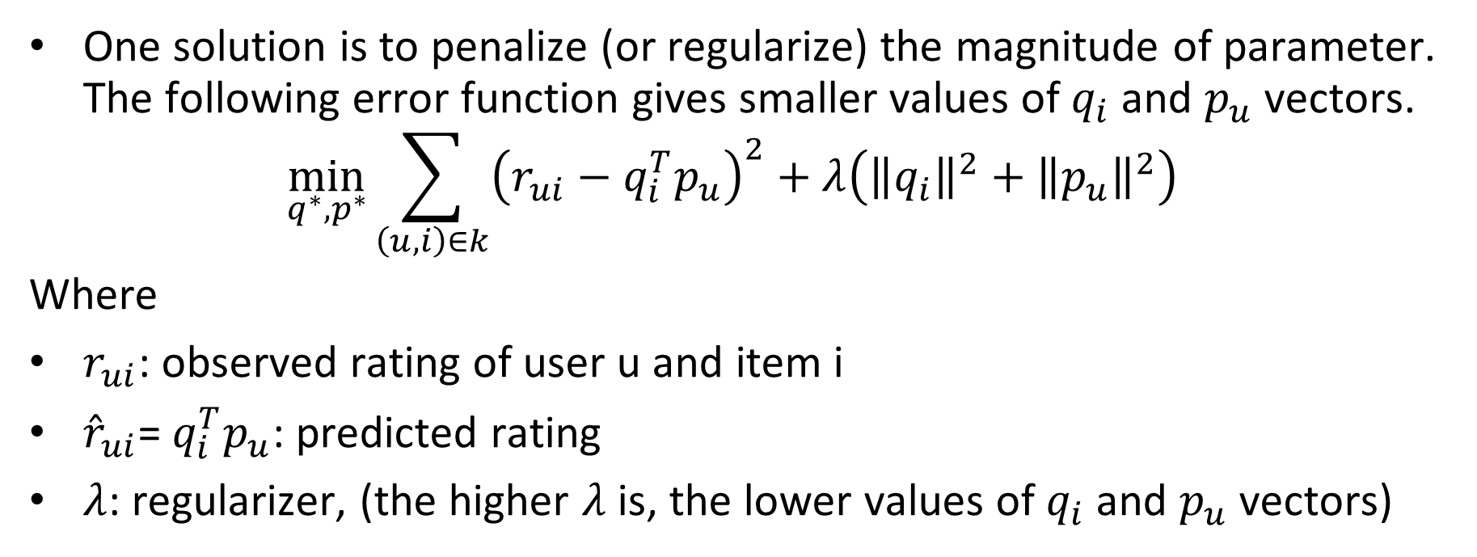
To prevent overfitting,
One solution is to penalize (or regularize) the magnitude of parameter. The following error function gives smaller values of $q_{i}$ and $p_{u}$ vectors.
$$\min_{q^{∗},p^{∗}}{\sum_{\left(u,i\right)∈k}{{\left(r_{ui}−q_{i}^{T}p_{u}\right)}^{2}+λ\left({\left\|q_{i}\right\|}^{2}+{\left\|p_{u}\right\|}^{2}\right)}}$$
Where
$r_{ui}$: observed rating of user u and item i
${\hat{r}}_{ui}\text{= }q_{i}^{T}p_{u}$: predicted rating
$λ$: regularizer, (the higher $λ$ is, the lower values of $q_{i}$ and $p_{u}$ vectors)

Slide 75
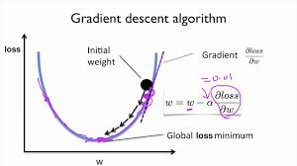
Step by step to reach the optimum value
weight = the value of parameter
Gradient = Slope =
Derivative

Slide 76
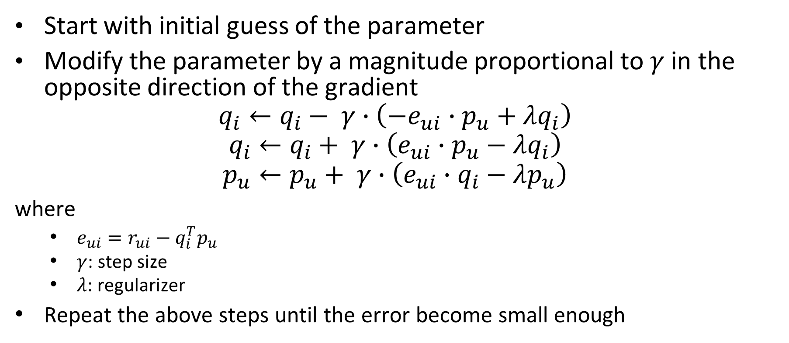
Step by step to reach the optimum value
Start with initial guess of the parameter
Modify the parameter by a magnitude proportional to $γ$ in the opposite direction of the gradient
$$q_{i}←q_{i}− γ∙\left(−e_{ui}∙p_{u}+λq_{i}\right)$$
$$q_{i}←q_{i}+ γ∙\left(e_{ui}∙p_{u}−λq_{i}\right)$$
$$p_{u}←p_{u}+ γ∙\left(e_{ui}∙q_{i}−λp_{u}\right)$$
where
$e_{ui}=r_{ui}−q_{i}^{T}p_{u}$
$γ$: step size
$λ$: regularizer
Repeat the above steps until the error become small enough

Slide 77

Better Rating Model
Predicted rating of user u and item i is
$${\hat{r}}_{ui}=μ+b_{i}+b_{u}+q_{i}^{T}p_{u}$$
where
$μ$: the overall average rating
$b_{i}$: the bias of item i (e.g. some movies are very popular.)
$b_{u}$: the bias of user u (e.g. some users tends to give high rating)
$q_{i}$: item i’s (feature level) vector
$p_{u}:$ user u’s (preference level) vector

Slide 78

Now, Error Function is
$$\min_{q^{∗},p^{∗},b^{∗}}{\sum_{\left(u,i\right)∈k}{\begin{aligned}{\left(r_{ui}−μ−b_{i}−b_{u}−q_{i}^{T}p_{u}\right)}^{2} \\ +λ\left({\left\|q_{i}\right\|}^{2}+{\left\|p_{u}\right\|}^{2}+{b_{u}}^{2}+{b_{i}}^{2}\right)\end{aligned}}}$$
where
$μ$: the overall average rating
$b_{i}$: the bias of item i (e.g. some movies are very popular.)
$b_{u}$: the bias of user u (e.g. some users tends to give high rating)
$q_{i}$: item i’s (feature level) vector
$p_{u}:$ user u’s (preference level) vector
$λ$: regularizer

Slide 79
Collaborative Filtering Summary
Neighbourhood methods
User-based CF
Item-based CF
Latent factor method
Matrix Factorization (MF)
Non-negative MF

Slide 80
Why MF > User-based CF, Item-based CF?
Often, MF has better prediction accuracy than neighbourhood-based CFs, which are user-based CF and item-based CF.
You will see it in the tutorial session.
Why?
User-based CF considers relations only among users.
Item-based CF considers relations only among item.
MF consider both relations to predict ratings.

Slide 81
Thank you very much

